Slide 1
Stop Competing
Start Collaborating
The Future of Rural Healthcare:
An Expert Panel Discussion

Slide 2
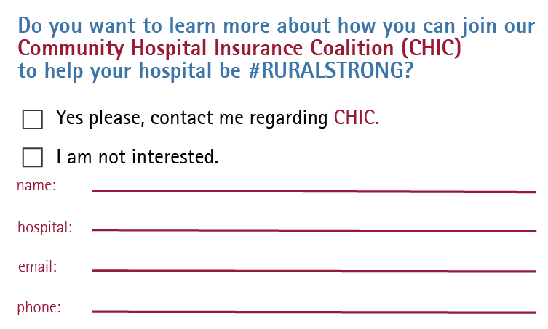
ENTER TO WIN

Slide 3
Community Hospital Insurance Coalition
NEXT LEVEL BUYING POWER

Slide 4
Stop Competing
Start Collaborating
THE PANEL
Fran McCown, CEO, Haskell County Hospital District
David Ashworth, Founding Member, LRC Advisors
Bill Haire, Founding Member, LRC Advisors
MODERATOR
Brant Couch, CIC, CPA, President HealthSure

Slide 5
LAST MAN STANDING MEMORIAL HOSPITAL
Notes:
STILL IN BUSINESS – people lining up to get in?

Slide 6
Redefining
Collaboration

Slide 7
Where It
All Started
Vision
To provide and maintain the highest and most sustainable level of primary care for the communities served

Slide 8
Our Vision
Defined
A regional approach integrating and coordinating networks of care
Promotes access to appropriate levels of quality health care
Improves clinical, operational and financial performance
Promotes innovation and sustainability
Helps avoid unnecessary duplication of resources
Promotes economies of scale

Slide 9
Our
Goals
Material change versus minor incremental change
Increases revenue growth and cost reduction opportunities
Stabilizes recruitment and retention of medical and hospital staff
Scalable platform for future opportunities and challenges
Legal structure for:
Antitrust protection
Service coordination
Service consolidation
Payer contracting
Notes:
We are not going to get out of our problems by cutting cost

Slide 10
The Future
of Rural Healthcare

Slide 12
Integration Continuum
- Some Possibilities
Increasing Level of Integration Between Partners
Collaboration / Network Affiliation / Management | Joint Operating Agreement | Capital Partner Joint Venture | Merger of Equals Joint Venture | Full Asset Merger / Acquisition
Form follows function
Each structure has advantages and disadvantages.
Start with mission and vision – then explore structure
Notes:
Form follows function - each of these has a set of benefits and set of pitfalls… ehst

Slide 13
Three Year
Transition Plan
TMHN Board
TMHN Board
CEO Council
(includes COO’s)
TMHN CEO
Year 3
FULLY OPERATIONAL
Year 1 Action Plan
&
Year 2 Action Plan
Notes:
Mention commonality of all the CEOs coming together – pages 6&7 from interview documents

Slide 14
Possible Shared
Services/Needs
Human resources
Purchasing/AP
Staff education/orientation
Quality improvement
Risk Management
Infection Control
Survey compliance
Emergency management training
Maintenance Support
Insurance contracting and credentialing
Contract maintenance for biomed
UR/discharge planning
Registered Dietician
EVS/food service
EMS coverage
Physician coverage
EMR system
Billing/Coding

Slide 15
Lessons
Learned

Slide 16
Pitfalls &
Banana Peels

Slide 17
How To
Get Started

Slide 18
Two Most
Important Questions
Is it your job to try to keep your hospital open?
Or is it your job to provide the best possible healthcare to the community you serve?

Slide 19
Contact
Fran McCown
fmccown@hmhhealth.org
(940) 864-2621
David Ashworth:
dcashworth5315@gmail.com
(214) 417-3871
Bill Haire:
billhaire60@yahoo.com
(540) 336-6748
Brant Couch:
brantc@healthsure.com
(512) 292-3315

Slide 20
Stop Competing
Start Collaborating
The Future of Rural Healthcare:
An Expert Panel Discussion

